Slide 1
Detection of diseases from facial features using Convolutional Neural Network
Ayush Kumar - 2017B5A70761P Project Report

Slide 2
Introduction
CNNs have been widely used for visual recognition tasks. One such task is detection of facial features to classify visually observable disease.
Rare diseases aﬀect almost 6-8% of the global population. An early detection of such diseases can help people ﬁgure out a way for proper prevention.

Slide 3
Related Works
Down syndrome diagnosis based on gabor wavelet transform: Saraydemir et al.
Identiﬁcation of dysmorphic syndromes using landmark-speciﬁc local texture descriptors: Cerrolaza et al.
Deep Learning Frame-Work for Recognizing Developmental Disorders : Shukla et al.

Slide 4
DeepGestalt -Identifying rare genetic syndromes using deep learning
This is by far the most successful framework for detection of multiple genetic syndrome using Computer Vision and deep learning
This model uses DCNN cascade based face detection then using 130 facial-landmarks, the image is geometrically normalised.
Regions of faces are trained on this model to get classification and is measured using top-n accuracy.

Slide 5
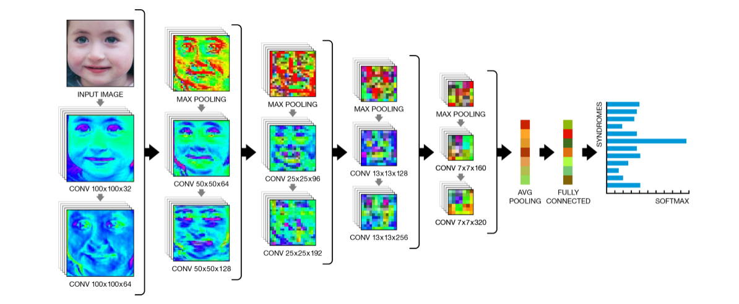
DeepGestalt -Identifying rare genetic syndromes using deep learning
Source: https://arxiv.org/pdf/1801.07637

Slide 6
Proposed Model

Slide 7
Pre-processing of the Image
The image that we are getting as input has been taken in real world in an uncontrolled condition.
We use the model proposed by Li et al. which is a cascade architecture built on CNN. It uses multiple resolutions and thus is able to reject most of the background in the quick initial low resolution stages of the processing.
A CNN based calibration of bounding boxes is done after each detection stage.

Slide 8
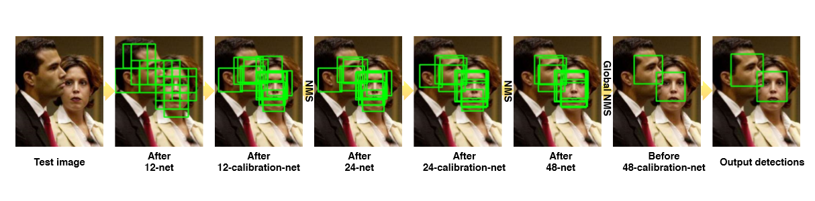
Pre-processing of the Image
Source: https://www.researchgate.net/publication/308864105_A_convolutional_neural_network_cascade_for_face_detection

Slide 9
Architecture for syndrome classiﬁcation
To learn the baseline facial recognition Inception-Resnet-v1 is used as backbone architecture.
To train the model for facial recognition task, the model is trained on CASIA web-face dataset .
A softmax classiﬁer is used on each facial region to make separate prediction for each region and then results are averaged out to make a robust multi-class prediction.

Slide 10
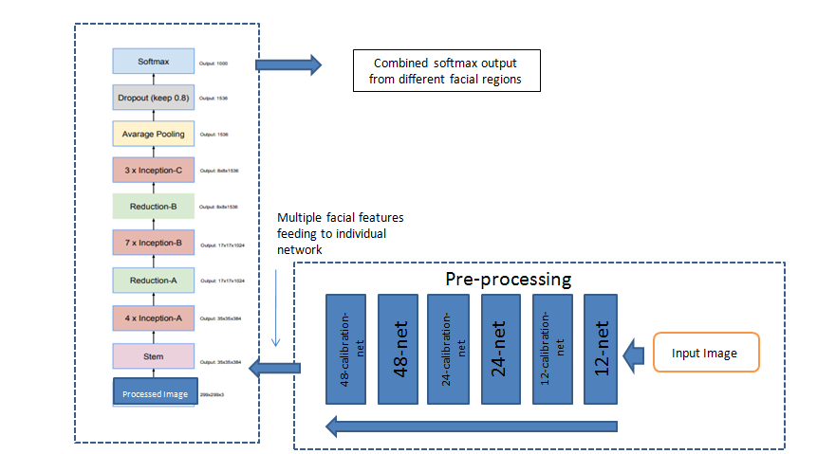
Architecture for syndrome classiﬁcation
Proposed architecture for syndrome classification

Slide 11
Metrics
Top-N accuracy will be used to analyse the results. Top-N accuracy basically measures how often the predicted class falls in top N values of softmax distribution.
Also, results will be evaluated using confusion matrix to visualize in what ways the model is making an inaccuracy in classifying the image.

Slide 12
Experiment and Results

Slide 13
Diseases considered in model
Down Syndrome: It occurs in about 1 in 1,000 babies born each year. Physical characteristics: a small chin, slanted eyes, poor muscle tone, a ﬂat nasal bridge, a single crease of the palm, and a protruding tongue due to a small mouth and relatively large tongue.
Fetal Alcohol Syndrome: (i) A smooth philtrum: The divot or groove between the nose and upper lip ﬂattens with increased prenatal alcohol exposure. (ii) Thin vermilion: The upper lip thins with increased prenatal alcohol exposure. (iii) Small palpebral ﬁssures: Eye width decreases with increased prenatal alcohol exposure.
Cerebral palsy: It causes paralysis or severe weakness of the facial muscles on one side of the face. It is believed to be due to a swelling of the nerve that controls the muscles of the face.

Slide 14
Training and Result
The training data consists of almost 20-25 images of each disease and 150 images of face with no genetic condition.
The model was trained on Google Colab. The last layer of both VGG and Inception Resnet was removed and replaced with softmax classiﬁer corresponding to the number of class of training dataset.
Inception Resnet architecture has 54,729,956 total parameters with 393,220 trainable parameters. The VGG 16 architecture has 14,815,044 total parameters and 100,356 trainable parameters. The model achieved a loss of 0.1617 remarkable accuracy of 0.9575.

Slide 15
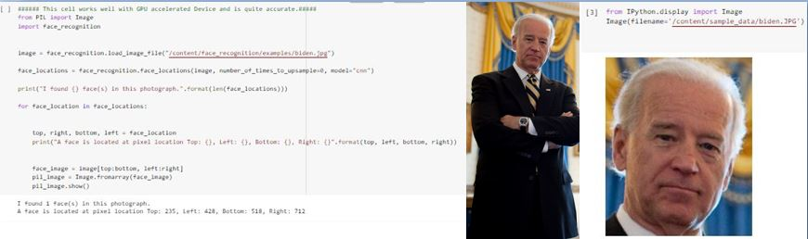
Pre Processing Result

Slide 16
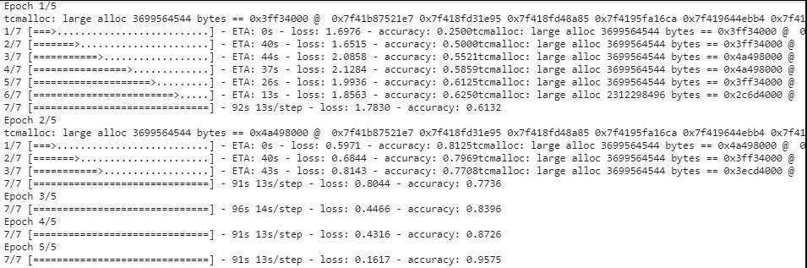
Final Result

Slide 17
Conclusion
With addition of more data in training and testing a more proper and elaborate result can be given and can help build an even powerful model.
This project has lot of future scopes by testing the data on diﬀerent architectures and adding additional input such as age and other parameters.

Slide 18
Thank You

